Slide 1
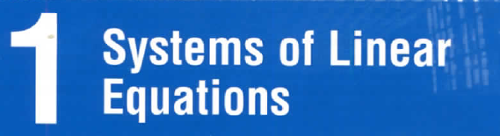
Chapter

Slide 2
Contents
1. Solutions and Elementary Operations
2. Gaussian Elimination
3. Homogeneous Equations

Slide 3
1.1. Solutions and Elementary Operations
coefficients
variables = unknowns
a₁x₁+a₂x₂+…+a_{n}x_{n}=b is called a linear equation (phương trình tuyến tính)
A solution (nghiệm) to the equation is a sequence s₁,s₂,…,s_{n} such that a₁s₁+a₂s₂+…+a_{n}s_{n}=b
s₁,s₂,…,s_{n} is called a solution to a system of linear equations if s₁,s₂,…,s_{n} is a solution to every equation of the system
A system may have:
no solution
unique solution
an infinite family of solutions
0
1
◎

Slide 4
A system that has no solution is called inconsistent (không tương thích/ không nhất quán)
A system that has at least one solution is called consistent (tương thích/ nhất quán)
Inconsistent (không tương thích) | Consistent (tương thích)
No solutions ( vô nghiệm) | Unique solution (nghiệm duy nhất) | Infinitely many solutions (vô số nghiệm)

Slide 5
Example 1
no solution
(0,2,1), (2,0,1)
(t,2-t,1)
Inconsistent
Consistent
(infinitely many solutions)
(t,2-t,1) is called a general solution and
given in parametric form, t is parameter
( t is arbitrary)

Slide 6



Elementary Operations (phép biến đổi sơ cấp)
Interchange two equations (type I)
Multiply one equation by a nonzero number (type II)
Add a multiple of one equation to a different equation (type III)

Slide 7
Algebraic Method
augmented matrix
coefficient matrix
constant matrix

Slide 8
Example 2
Consider the system
augmented matrix

Slide 9
Example 2
Solution (0,-1)
Theorem. Suppose an elementary operation is performed on a system of linear equations. Then the resulting system has the same set of solutions as the original system, so the two system are equivalent (tương đương)
In this case,their augmented matrices are called row-equivalent

Slide 10
1.2. Gaussian Elimination (phép khử Gauss)
By using elementary row operations to carry the augment matrix to “nice” matrix such as
( and it is said to be in row- echelon form
(dạng bậc thang theo dòng))

Slide 11
A row-echelon matrix has 3 properties
All the zero rows are at the bottom
The first nonzero entry from the left in each nonzero row is a 1, called the leading 1 for that row
Each leading 1 is to the right of all leading 1’s in the rows above it

Slide 12
Row-echelon matrix
The row-echelon matrix has the “staircase” form
leading ones
( for any choice in *-position )

Slide 13
Which is a row-echelon matrix?

Slide 14
A reduced row-echelon matrix (ma trận bậc thang theo dòng thu gọn) has the properties
It is a row-echelon matrix
Each leading 1 is the only nonzero entry in its column

Slide 15
Which is a reduced row- echelon matrix?

Slide 16
How to carry a matrix to (reduced) row-echelon form?

Slide 17
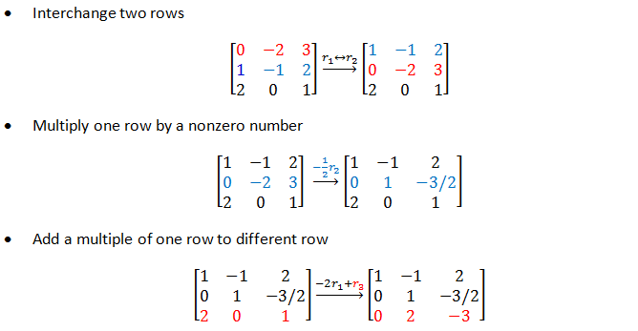
Elementary row operations

Slide 18
Gaussian Algorithm
Theorem. Every matrix can be brought to (reduced) row-echelon form by a series of elementary row operations
Step 1. If all row are zeros, stop
Step 2. Otherwise, find the first column from the left containing a nonzero entry (call it a) and move the row containing a to the top position
Step 3. Multiply that row by 1/a to creat the leading 1
Step 4. By subtracting multiples of that row from the rows below it, make each entry below the leading 1 zero
Step 5. Repeat step 1-4 on the matrix consisting of the remaining rows

Slide 19
Gaussian Algorithm
leading one
step 2
step 3
step 4
step 5

Slide 20
Example
Carry the matrix
to row-echelon matrix
to reduced row-echelon matrix

Slide 21
row-echelon matrix

Slide 22
reduced row-echelon matrix

Slide 23
Do yourself – carry these matrices to reduced row-echelon matrices

Slide 24
Gauss-Jordan Elimination (for solving a system of linear equantions)
Step 1.Using elementary row operations, augmented matrix → reduced row-echelon matrix
Step 2. If a row [0 0 0…0 1] occurs, the system is inconsistent
Step 3. Otherwise, assign the nonleading variables as parameters, solve for the leading variables in terms of parameters
reduced row echelon matrix
z=t (parameter)
z is nonleading variable
Notes:
Với hệ tương thích (có nghiệm):
Gọi n là số lượng ẩn
m là số lượng phương trình
r là số lượng leading one
1) nếu r=n thì hệ có 1 nghiệm
2) nếu r<n hệ có vô só nghiệm, có (n-r) tham số

Slide 25
inconsistent
Notes:
Gặp dạng 0 0 0 | 1 là dạng vô nghiệm

Slide 26
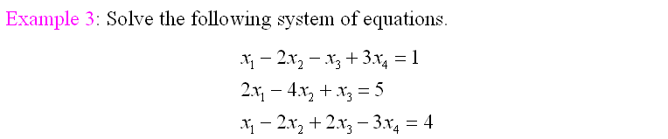
leading one
reduced row echelon matrix
x₂,x₄ are nonleading variables, so we set
x₂=t and x₄=s (parameters) and then compute x₁, x₃
x₁ = 2 + 2t - s
x₂ = t
x₃ = 1 + 2s
x₄ = s
Notes:
Dựa vào cột ko có leading one để tìm ẩn
x1=2+2t-s
x2= t
x3=1+ 2s
x4= s
Gọi là nghiệm tổng quát của hệ PT

Slide 27
Do yourself – solve the following systems given by augmented matrices

Slide 28
Example
Which condition on the numbers a,b,c is the system
consistent ?
Answer: c-2a+b=0

Slide 29
The rank of a matrix
The reduced row-echelon form of a matrix A is uniquely determined by A, but the row-echelon form of A is not unique
The number r of leading 1’s is the same in each of the different row-echelon matrices
As r depends only on A and not on the row-echelon forms, it is called the rank of the matrix A, and written r=rankA

Slide 30
The rank of a matrix
If the a matrix A has the row-echelon matrix is
then rankA=4

Slide 31
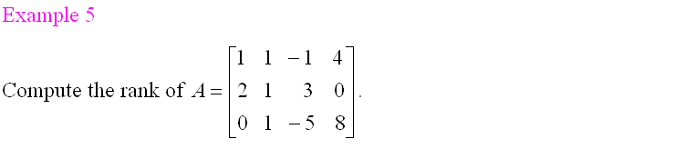
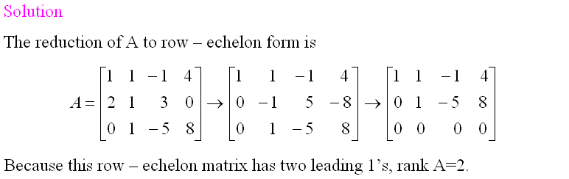

Slide 32
Theorem 2
Suppose a system of m equations in n variables has a solution. If the rank of the augment matrix is r then the set of solutions involves exactly n-r parameters
leading one
rankA=2
4(number of variables)- 2(rankA) =2 (two parameters : x₂=t, x₄=s)

Slide 33
1.3.Homogeneous Equations (phương trình thuần nhất)
The system is called homogeneous (thuần nhất) if the constant matrix has all the entry are zeros
Note that every homogeneous system has at least one solution (0,0,…,0), called trivial solution (nghiệm tầm thường)
If a homogeneous system of linear equations has nontrivial solution (nghiệm không tầm thường) then it has infinite family of solutions (vô số nghiệm)
Notes:
Hệ thuần nhất có vế trái full 0
Hệ thuần nhất có ít nhất 1 nghiệm (0,0,0..0) gọi là nghiệm tầm thường

Slide 34
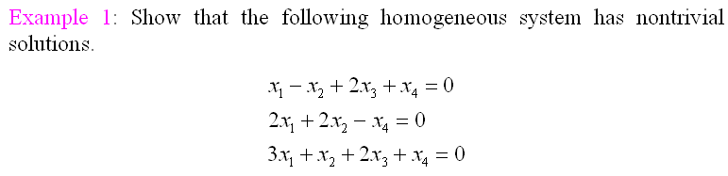

Slide 35
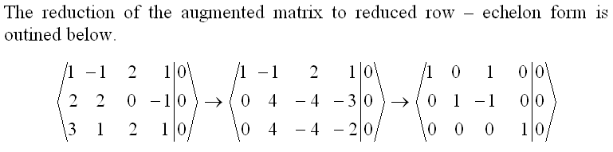
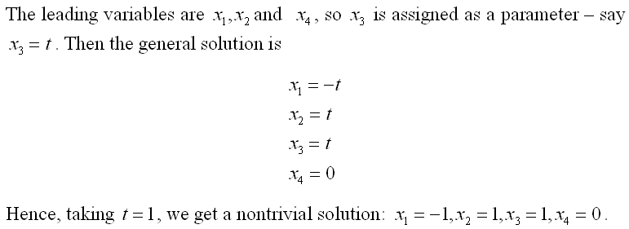
Hệ thuần nhất mà số ẩn
nhiều hơn số pt (n>m)
Chắc chắn vô số nghiệm

Slide 36
Theorem 1
If a homogeneous system of linear equations has more variables than equations, then it has nontrivial solution (in fact, infinitely many)
Note that the converse of theorem 1 is not true

Slide 37
System of equations Summary
System of | Inconsistent ( no solutions) | Cosistent
 |  | Unique solution (exactly one solution) | Infinitely many solutions
linear equations | yes | yes | yes
linear equations that has more variables than equations | yes | no | yes
homogeneous linear equations | no | yes | yes
homogeneous linear equations that has more variables than equations | no | no | yes

Slide 38
Exercises
1. Find all a,b such that the matrix is an reduced row-echelon matrix.
◻ a=b=1
◻ a=0 and b=1
◻ a=b=0
☑ a=1 and b=0
◻ None of the others

Slide 39
Exercises
2. Find all values of m such that the system has no solution, (another word: inconsistent)
Answer:
Carry the augmented matrix to row-echelon form
The system has no solution iff m≠7

Slide 40
Exercises
3. Choose the correct statements.
☑ If the system has trivial solution, then it is a homogeneuos system
◻ A homogeneous system of 7 equations and 5 variables always has many solutions
☑ A consistent system of 12 equations and 15 unknowns must have infinitely many solutions
☑ If a homogeneous system has an nontrivial solution, then it has infinitely many solutions
Homogeneous + more variables than equations  many solutions (vsn),
chắc chắn có nghiệm không tầm thường
Homogeneous + exist nontrivial solution  infinitely many solutions (vsn)

Slide 41
Exercises
4. Consider a system of 203 linear equations in 133 variables. Choose the correct statements.
☑ If the system is homogeneous there is always at least one solution
☑ There may be infinitely many solutions.
◻ There may be exactly three solutions.
◻ If the system is homogeneous there are always infinitely many solutions.
☑ There may be exactly one solution.
◻ There is always at least one solution.
☑ There may be no solution
Homogeneous  consistent (luôn có ít nhất một nghiệm)

Slide 42
Exercises
5. Find the rank of the matrix.
◻ 1
☑ 2
◻ 3
◻ 4
◻ 3x3
rankA = the number of leading ones in the row echelon form of A

Slide 43
Exercises
6. Find all values of m such that the matrix has the rank 2.
Answer:
Carry the augmented matrix to row-echelon form
rankA=2 iff m=5 (rankA=3 iff m ≠5)
rankA=the number of leading ones in the row echelon form of A

Slide 44
Exercises
7. Given a homogeneous system of 23 unkowns (n=23) and 35 equations. Suppose the augmentad matrix of the system has the rank 17 (r=17). How many parameters in the solution of the system?
◻ 17
◻ 23
◻ 12
☑ 6
◻ None of the others
x₁ x₂ x₃ x₄
Number of parameters = number of nonleading variables
= n - r (số ẩn – hạng ma trận)
r = rankA = number of leading ones
leading variables: x₁, x₃
nonleading variables: x₂, x₄

Slide 45
Exercises
8. Solve the homogeneous system
Carry the augmented matrix to (reduced) row-echelon form
Solution: w=t, z=4t, y=3t, x=3t
w is nonleading variable, so w=parameter=t

Slide 46
Exercises
◻ m=1
☑ m=±2
◻ m=0
◻ m= ± 1
◻ m=3

Slide 47
Exercises
◻ m≠1
☑ m = -1
◻ m=1
◻ m= ± 1
◻ m ≠-1

Slide 48
THANK YOU

Slide 49
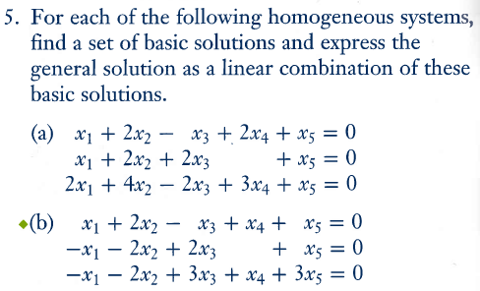

Slide 50
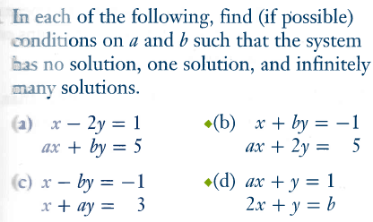

Slide 51
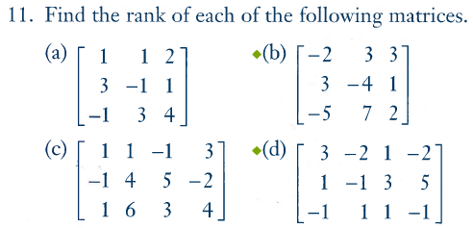

Slide 52
